Slide 1

Statistics for Business
Session 3 of
Dr. Suresh Kumar Gadi
Universidad de las Américas Puebla

Slide 2
Today’s topic
Introduction Probability

Slide 3

Counting principle/rule
If there are $m$ ways of doing activity-$1$ and $n$ ways of doing activity-$2$, then there are $m×n$ ways of doing both activities $1$ and $2$.

Slide 4
Examples
Martin has 2 shirts and 3 pants, then he has _____ possible outfit choices.
You have a deck of 52 cards, a die with 6 sides, and a coin with 2 sides. If you are asked to select one card from the deck, one side of die, and one side of the coin, then how many options do you have?
John received a new credit card. The card came with a default PIN which is a 4 digit number. The bank manager advised him to change the PIN as early as possible. How many options does John has to for the new PIN?

Slide 5

Solutions
Martin has $2×3=6$ options for his outfit
You have $52×6×2=624$
Number of possible PINs are $10×10×10×10=10000$. And John has $10000−1=9999$ options for his new PIN.

Slide 6

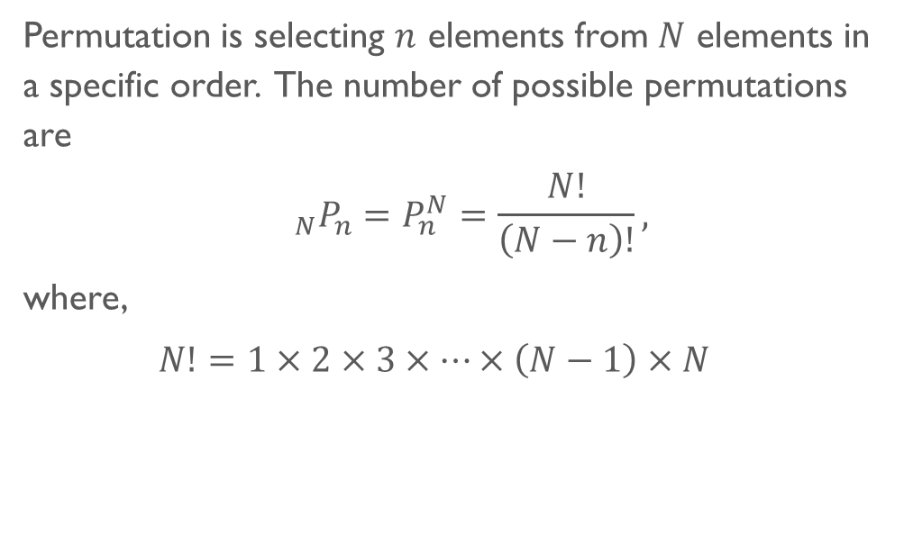
Permutations
Permutation is selecting $n$ elements from $N$ elements in a specific order. The number of possible permutations are
$${}_{N}P_{n}=P_{n}^{N}=\frac{N!}{\left(N−n\right)!},$$
where,
$N!=1×2×3×…×\left(N−1\right)×N$

Slide 7
Example
You are organizer of a prestigious 4 day conference. Each day of the conference should start with a key-note speaker. Your team identified 10 possible candidates for the key-note speakers. How many options do you have?

Slide 8
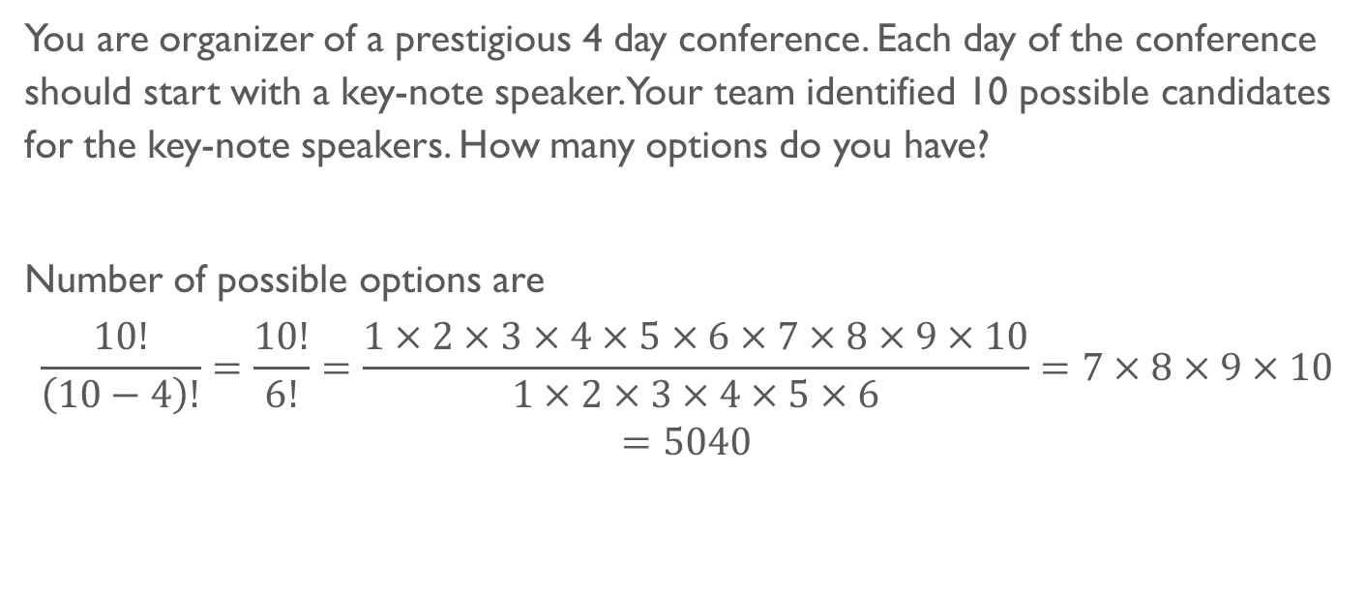
Solution
You are organizer of a prestigious 4 day conference. Each day of the conference should start with a key-note speaker. Your team identified 10 possible candidates for the key-note speakers. How many options do you have?
Number of possible options are
$$\frac{10!}{\left(10−4\right)!}=\frac{10!}{6!}=\frac{1×2×3×4×5×6×7×8×9×10}{1×2×3×4×5×6}=7×8×9×10=5040$$

Slide 9

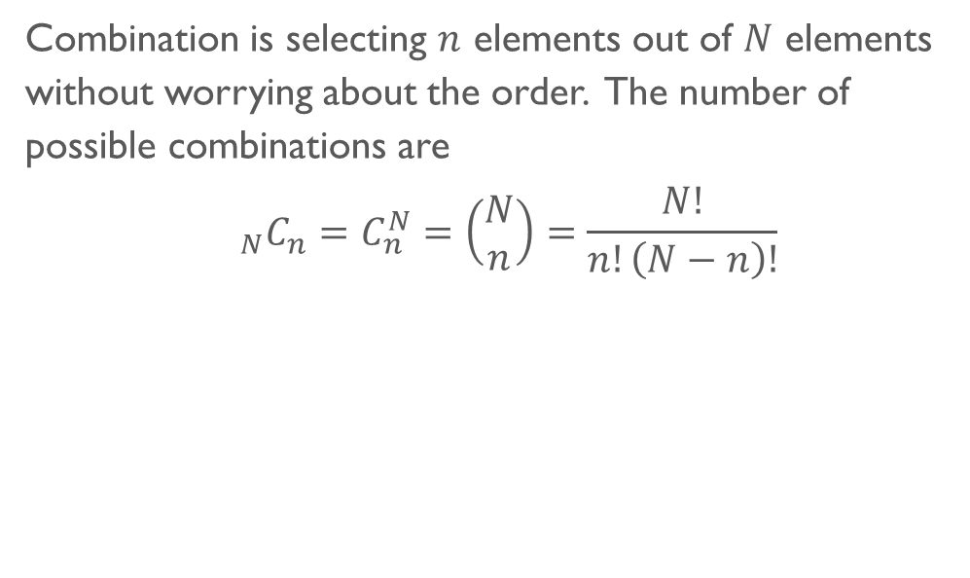
Combinations
Combination is selecting $n$ elements out of $N$ elements without worrying about the order. The number of possible combinations are
$${}_{N}C_{n}=C_{n}^{N}=\left(\begin{matrix}N \\ n\end{matrix}\right)=\frac{N!}{n!\left(N−n\right)!}$$

Slide 10
Example
As a portfolio manager in a small hedge fund, you’ve decided to create a new fund that will attract risk-taking investors. The fund will include five stocks of fast-growing companies that offer high growth potential. Your team of analysts identified 20 companies that suit the profile. How many possible combinations are there for your new fund?

Slide 11
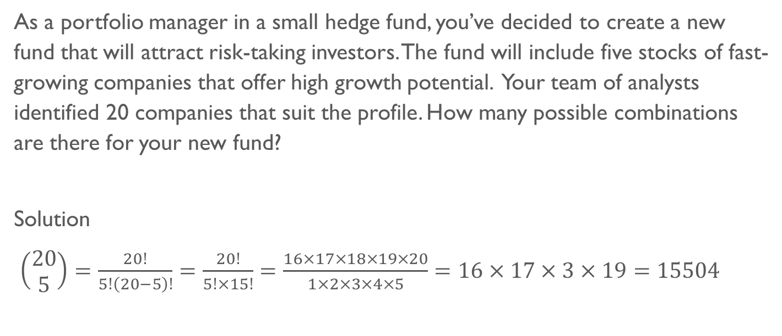
Solution
As a portfolio manager in a small hedge fund, you’ve decided to create a new fund that will attract risk-taking investors. The fund will include five stocks of fast-growing companies that offer high growth potential. Your team of analysts identified 20 companies that suit the profile. How many possible combinations are there for your new fund?
Solution
$\left(\begin{matrix}20 \\ 5\end{matrix}\right)=\frac{20!}{5!\left(20−5\right)!}=\frac{20!}{5!×15!}=\frac{16×17×18×19×20}{1×2×3×4×5}=16×17×3×19=15504$

Slide 12

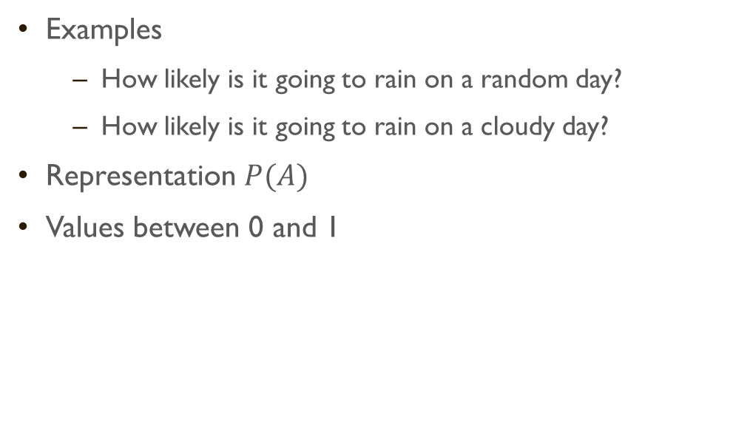
Probability
Examples
How likely is it going to rain on a random day?
How likely is it going to rain on a cloudy day?
Representation $P(A)$
Values between 0 and 1

Slide 13

Terminology
Experiment
Random experiment
Sample space
Outcome
Event
Trail

Slide 14
Sample space representation
List of the possible outcomes
Tree diagram
Venn diagram

Slide 15
Example List of possible outcomes
 | Die 2
Die 1 |  | 1 | 2 | 3 | 4 | 5 | 6
 | 1 | 1, 1 | 1, 2 | 1, 3 | 1, 4 | 1, 5 | 1, 6
 | 2 | 2, 1 | 2, 2 | 2, 3 | 2, 4 | 2, 5 | 2, 6
 | 3 | 3, 1 | 3, 2 | 3, 3 | 3, 4 | 3, 5 | 3, 6
 | 4 | 4, 1 | 4, 2 | 4, 3 | 4, 4 | 4, 5 | 4, 6
 | 5 | 5, 1 | 5, 2 | 5, 3 | 5, 4 | 5, 5 | 5, 6
 | 6 | 6, 1 | 6, 2 | 6, 3 | 6, 4 | 6, 5 | 6, 6

Slide 16
Example List of possible outcomes
A restaurant offers a set menu with a choice of three starters - soup (S), prawn cocktail (P) or bruschetta (B), and three main courses - lamb (L), hake (H) or chicken (C).
 | Soup | Prawn cocktail | Bruschetta
Lamb | L, S | L, P | L, B
Hake | H, S | H, P | H, B
Chicken | C, S | C, P | C, B

Slide 17
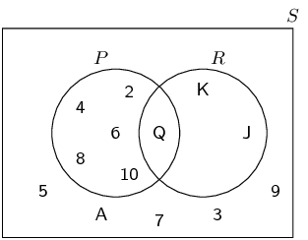
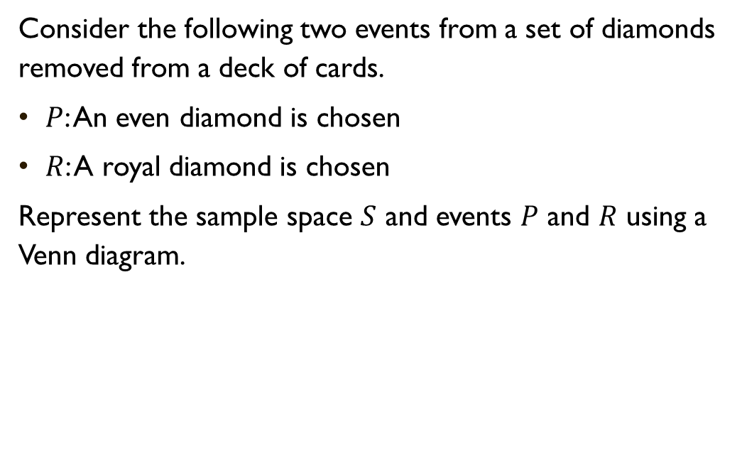
Example Venn diagrams
Consider the following two events from a set of diamonds removed from a deck of cards.
$P$: An even diamond is chosen
$R$: A royal diamond is chosen
Represent the sample space $S$ and events $P$ and $R$ using a Venn diagram.

Slide 18
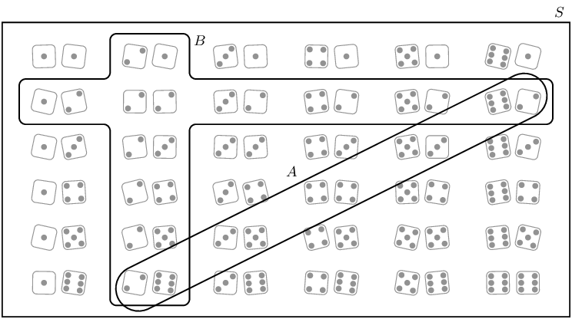
Example Venn diagram
Represent the sample space of two rolled dice and the following two events using a Venn diagram:
Event A: the sum of the dice equals 8
Event B: at least one of the dice shows 2

Slide 19
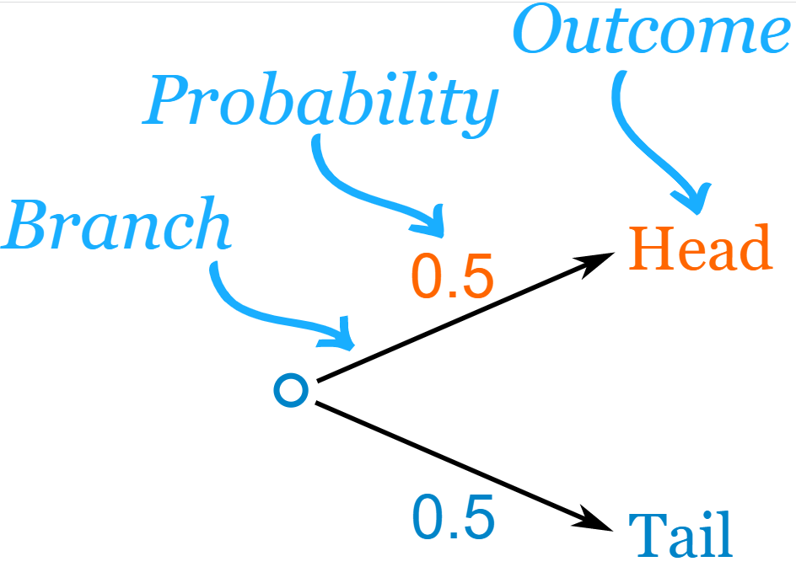
Tree diagram
How to prepare it?

Slide 20
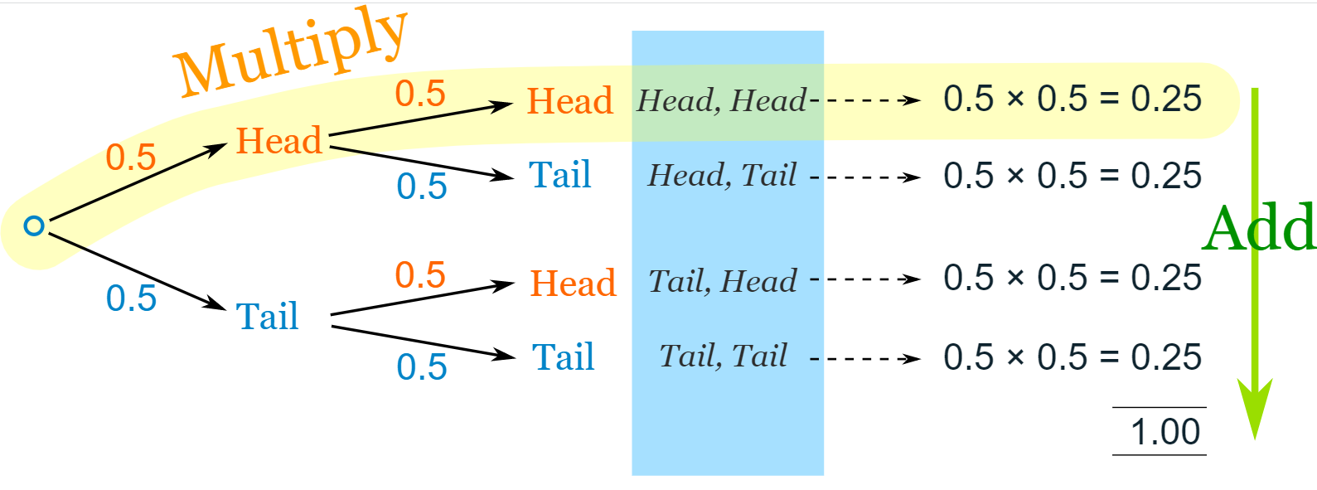
Tree diagram
How do we use it?

Slide 21
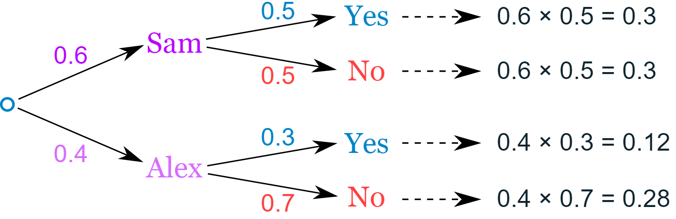
Tree diagram Example
You are off to soccer, and love being the Goalkeeper, but that depends who is the Coach today:
with Coach Sam the probability of being Goalkeeper is 0.5
with Coach Alex the probability of being Goalkeeper is 0.3
Sam is Coach more often ... about 6 out of every 10 games (a probability of 0.6).

Slide 22
Example Relative frequency
Cause | Number of deaths
Transportation | 1705
Violent events | 837
Equipment accidents | 741
Falls | 645
Chemical | 404
Fires and explosions | 113
The following table displays causes of death in the workplace in the US. If we select of death from this population
What is the probability that this death was from a fall?
What is the probability that this death was from a transportation accident?

Slide 23

Solution Relative frequency
Cause | Number of deaths | Relative frequency | % Relative frequency
Transportation (T) | 1705 | 0.3836 | 38.36
Violent events (V) | 837 | 0.1883 | 18.83
Equipment accidents (E) | 741 | 0.1667 | 16.67
Falls (F) | 645 | 0.1451 | 14.51
Chemical (C) | 404 | 0.0909 | 9.09
Fires and explosions (X) | 113 | 0.0254 | 2.54
Total | 4445 | 1.0000 | 100.00
What is the probability that this death was from a fall?
$$P(F)=0.1451$$
What is the probability that this death was from a transportation accident?
$$P(T)=0.3836$$

Slide 24

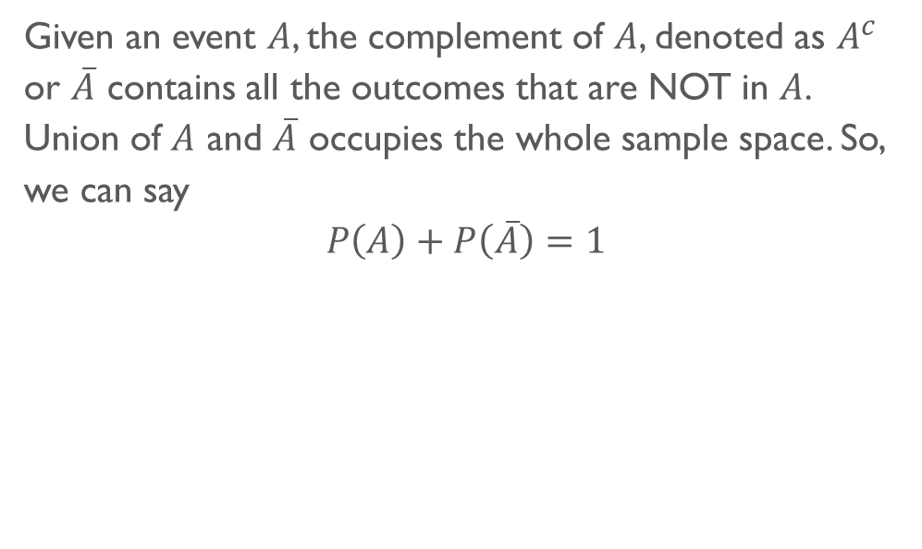
Compliment
Given an event $A$, the complement of $A$, denoted as $A^{c}$ or $\overline{A}$ contains all the outcomes that are NOT in $A$. Union of $A$ and $\overline{A}$ occupies the whole sample space. So, we can say
$$P\left(A\right)+P\left(\overline{A}\right)=1$$

Slide 25
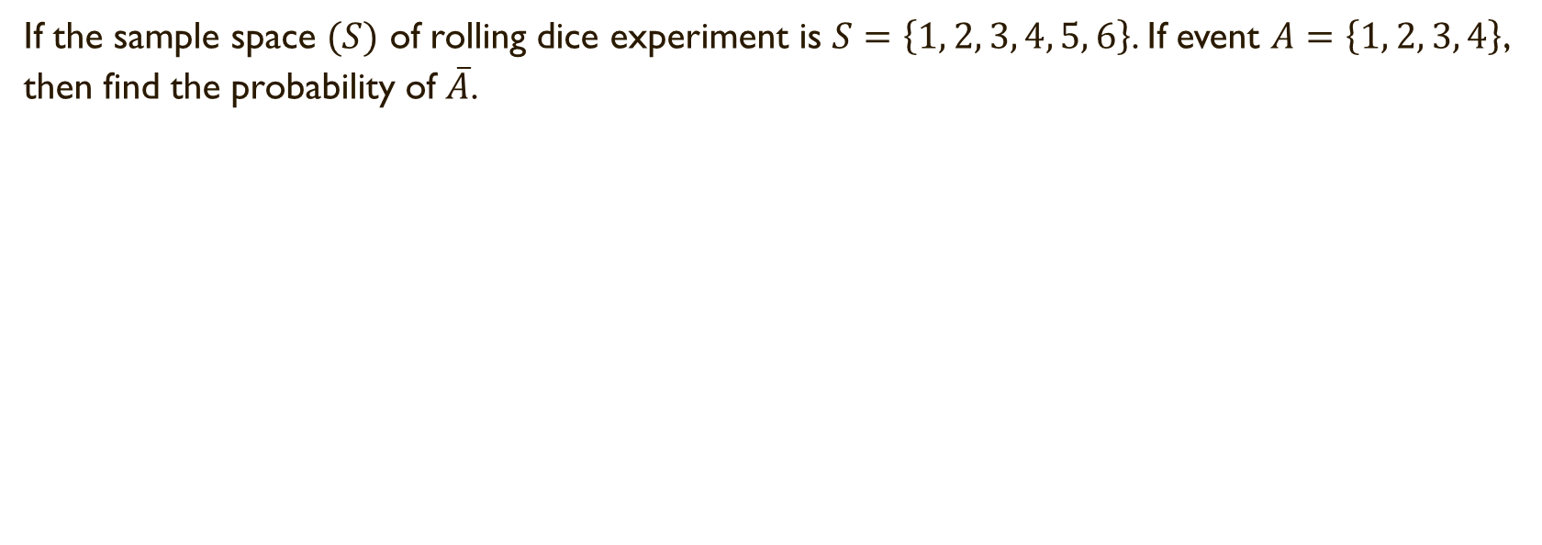
Example Compliment
If the sample space $(S)$ of rolling dice experiment is $S=\left\{1, 2, 3, 4, 5, 6\right\}$. If event $A=\left\{1, 2, 3, 4\right\}$, then find the probability of $\overline{A}$.

Slide 26

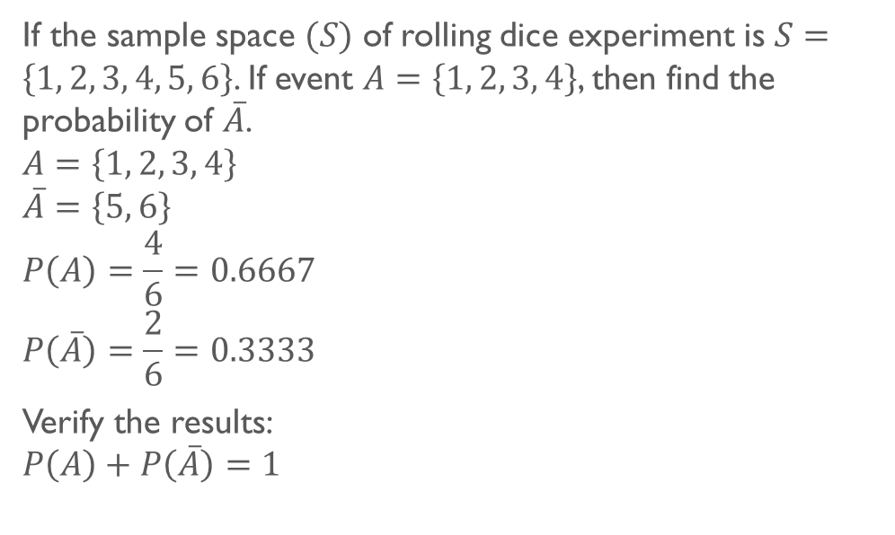
Solution Compliment
If the sample space $(S)$ of rolling dice experiment is $S=\left\{1, 2, 3, 4, 5, 6\right\}$. If event $A=\left\{1, 2, 3, 4\right\}$, then find the probability of $\overline{A}$.
$$A=\left\{1, 2, 3, 4\right\}$$
$$\overline{A}=\left\{5, 6\right\}$$
$$P\left(A\right)=\frac{4}{6}=0.6667$$
$$P\left(\overline{A}\right)=\frac{2}{6}=0.3333$$
Verify the results:
$$P\left(A\right)+P\left(\overline{A}\right)=1$$

Slide 27
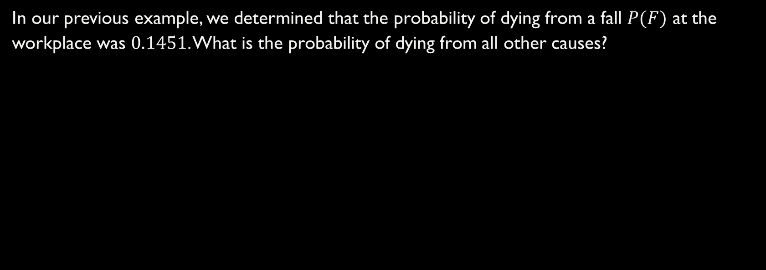
Example Compliment
In our previous example, we determined that the probability of dying from a fall $P(F)$ at the workplace was $0.1451$. What is the probability of dying from all other causes?

Slide 28

Solution Compliment
In our previous example, we determined that the probability of dying from a fall $P(F)$ at the workplace was $0.1451$. What is the probability of dying from all other causes?
We know that:
$$P\left(F\right)+P\left(\overline{F}\right)=1$$
Hence probability of dying from all other causes is:
$$P\left(\overline{F}\right)=1−P\left(F\right)=1−0.1451=0.8549$$

Slide 29

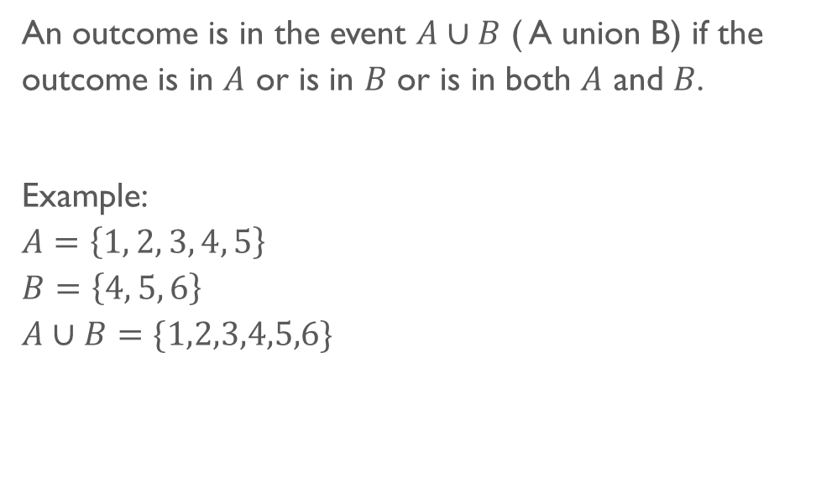
Union
An outcome is in the event $A∪B$ ( A union B) if the outcome is in $A$ or is in $B$ or is in both $A$ and $B$.
Example:
$$A=\left\{1, 2, 3, 4, 5\right\}$$
$$B=\left\{4, 5, 6\right\}$$
$$A∪B=\{1,2,3,4,5,6\}$$

Slide 30
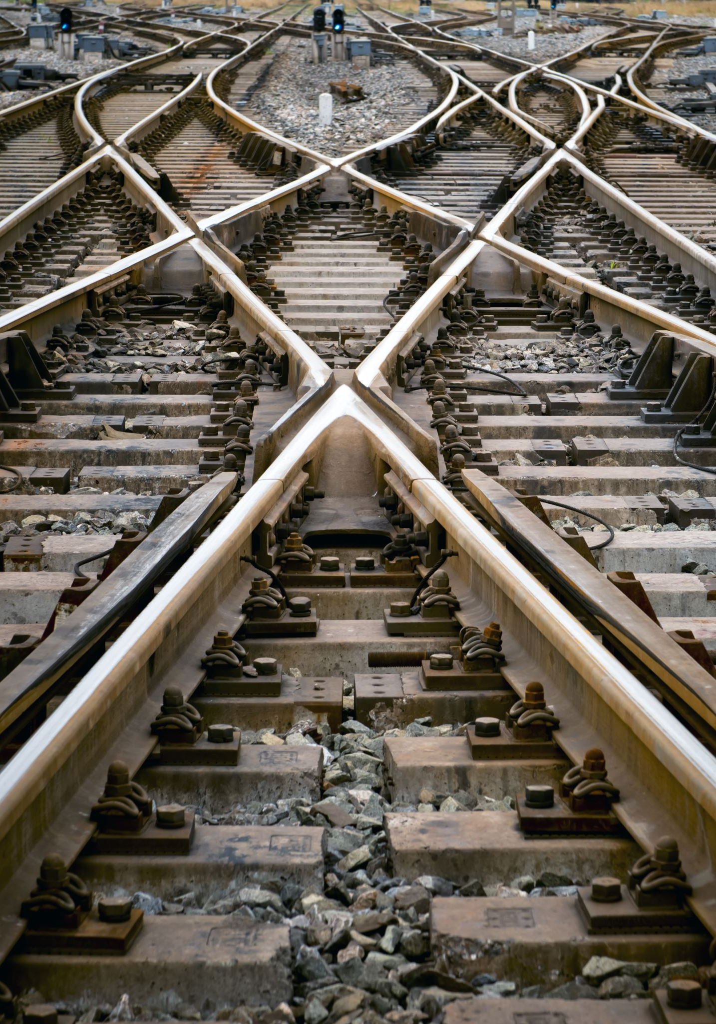
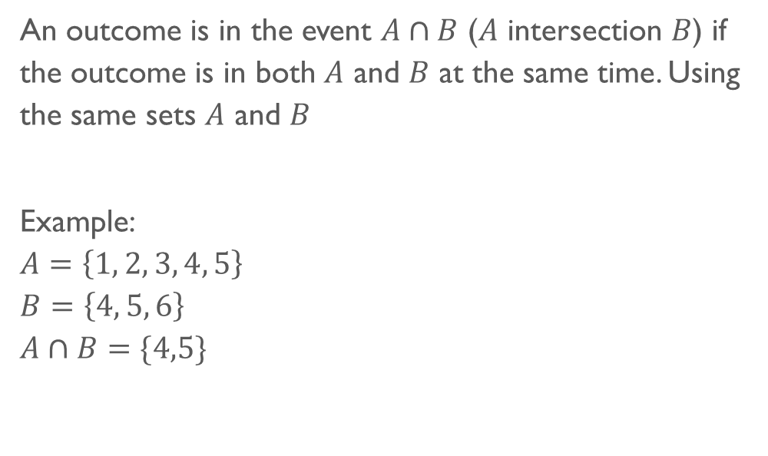
Intersection
An outcome is in the event $A∩B$ ($A$ intersection $B$) if the outcome is in both $A$ and $B$ at the same time. Using the same sets $A$ and $B$
Example:
$$A=\left\{1, 2, 3, 4, 5\right\}$$
$$B=\left\{4, 5, 6\right\}$$
$$A∩B=\{4,5\}$$

Slide 31

Addition law of probability
Addition law gives the probability of union of two events $A$ and $B$ as
$$P\left(A∪B\right)=P\left(A\right)+P\left(B\right)−P(A∩B)$$

Slide 32

Example
Imagine we are studying complaints from a service provided. Out of 100 services, we found out that 10 out of the 100 had complaints regarding delay in the service, 15 out of the 100 had complaints regarding the quality of the service, and 5 out of 100 had complaints regarding delays and quality of service. Based on this we decided to assign warnings to employees providing services that have delays or with low quality. What is the probability that we assign a warning to one of our employees?

Slide 33
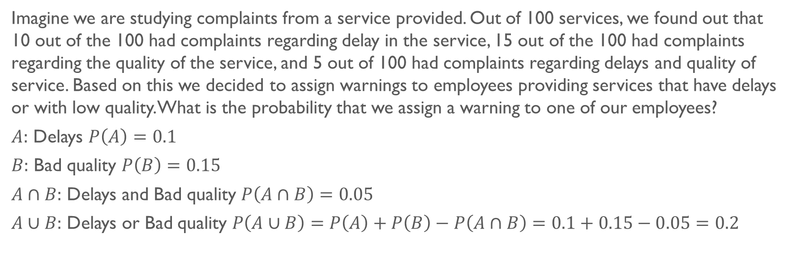
Solution
Imagine we are studying complaints from a service provided. Out of 100 services, we found out that 10 out of the 100 had complaints regarding delay in the service, 15 out of the 100 had complaints regarding the quality of the service, and 5 out of 100 had complaints regarding delays and quality of service. Based on this we decided to assign warnings to employees providing services that have delays or with low quality. What is the probability that we assign a warning to one of our employees?
$A:$ Delays $P\left(A\right)=0.1$
$B:$ Bad quality $P\left(B\right)=0.15$
$A∩B:$ Delays and Bad quality $P\left(A∩B\right)=0.05$
$A∪B:$ Delays or Bad quality $P\left(A∪B\right)=P\left(A\right)+P\left(B\right)−P\left(A∩B\right)=0.1+0.15−0.05=0.2$

Slide 34

Mutually exclusive Events
We say that two events are mutually exclusive if when one occurs, the other one can’t occur (at the same time). Therefore, for $A$ and $B$ to be mutually exclusive we see that there can’t be elements in the intersection of the two events.
So,
$$P\left(A∩B\right)=0$$
And hence addition law is simplified to
$$P\left(A∪B\right)=P\left(A\right)+P(B)$$

Slide 35
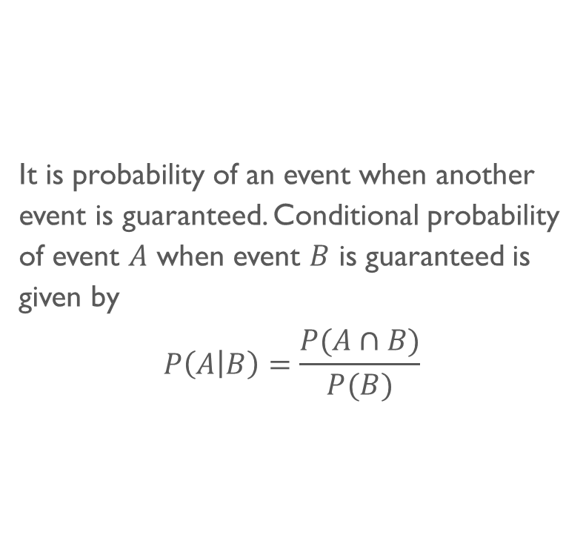
Conditional probability
It is probability of an event when another event is guaranteed. Conditional probability of event $A$ when event $B$ is guaranteed is given by
$$P\left(A | B\right)=\frac{P(A∩B)}{P(B)}$$

Slide 36
Example
What is probability of obtaining 1 or 2 as outcome on a die roll if it is know that the outcome is an even number?

Slide 37

Solution
What is probability of obtaining 1 or 2 as outcome on a die roll if it is know that the outcome is an even number?
Sample space $S=\left\{1, 2, 3, 4, 5, 6\right\}$
$A:$ Outcome is 1 or 2: $A=\{1, 2\}$
$B:$ Outcome is even: $B=\left\{2, 4, 6\right\}⇒P\left(B\right)=\frac{3}{6}=0.5$
$$A∩B=\left\{2\right\}⇒P\left(A∩B\right)=\frac{1}{6}$$
$$P\left(A | B\right)=\frac{P(A∩B)}{P(B)}=\frac{1/6}{0.5}=\frac{1}{3}$$

Slide 38
Example
Supposed we have classified 161 employees according to two criteria as shown in the table. If we select a person at random and we know this person is female, what is the probability she is under 30?
 | Male (M) | Female (F) | Total
Under 30 (U) | 54 | 47 | 101
Above 30 (A) | 28 | 32 | 60
Total | 82 | 79 | 161

Slide 39
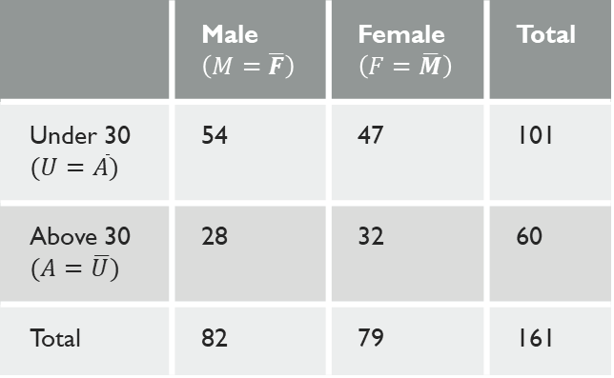
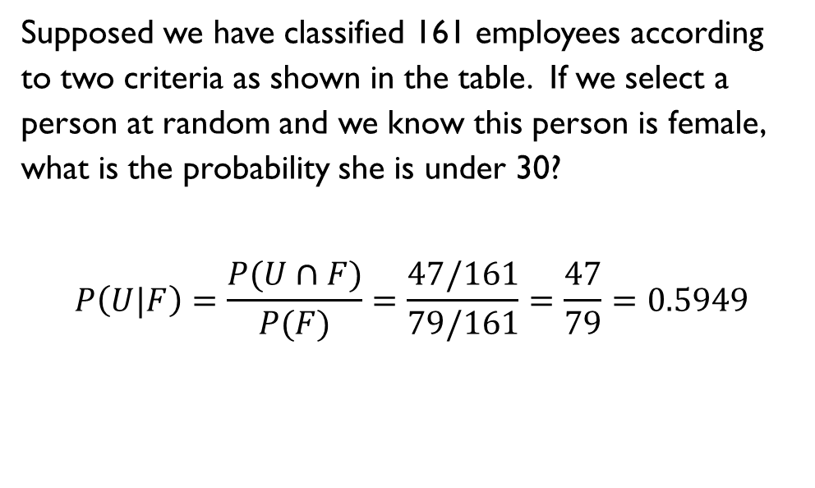
Solution
Supposed we have classified 161 employees according to two criteria as shown in the table. If we select a person at random and we know this person is female, what is the probability she is under 30?
$$P\left(U|F\right)=\frac{P(U∩F)}{P(F)}=\frac{47/161}{79/161}=\frac{47}{79}=0.5949$$
 | Male $\left(M=\overline{F}\right)$ | Female $\left(F=\overline{M}\right)$ | Total
Under 30 $(U=\overline{A})$ | 54 | 47 | 101
Above 30 $(A=\overline{U})$ | 28 | 32 | 60
Total | 82 | 79 | 161

Slide 40

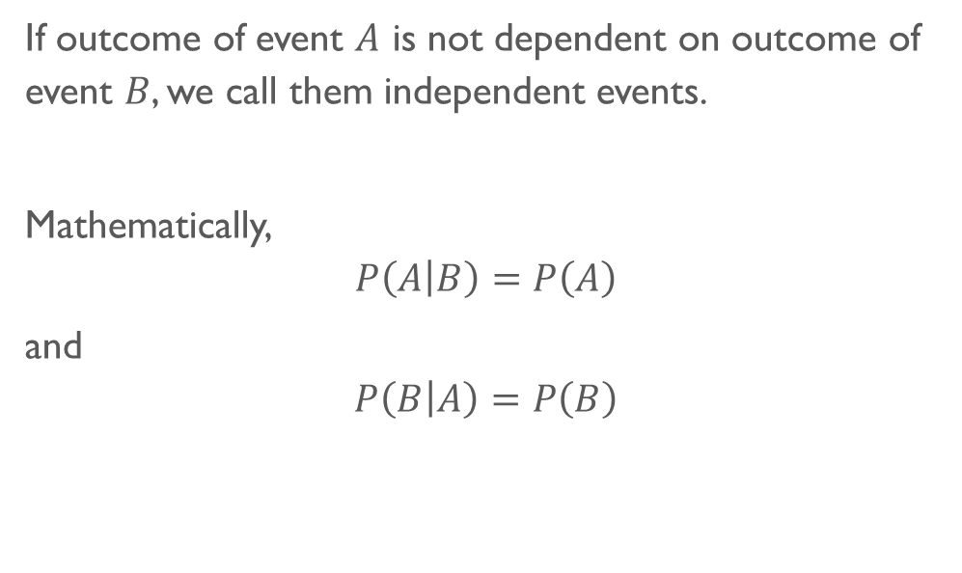
Independent events
If outcome of event $A$ is not dependent on outcome of event $B$, we call them independent events.
Mathematically,
$$P\left(A | B\right)=P\left(A\right)$$
and
$$P\left(B | A\right)=P\left(B\right)$$

Slide 41

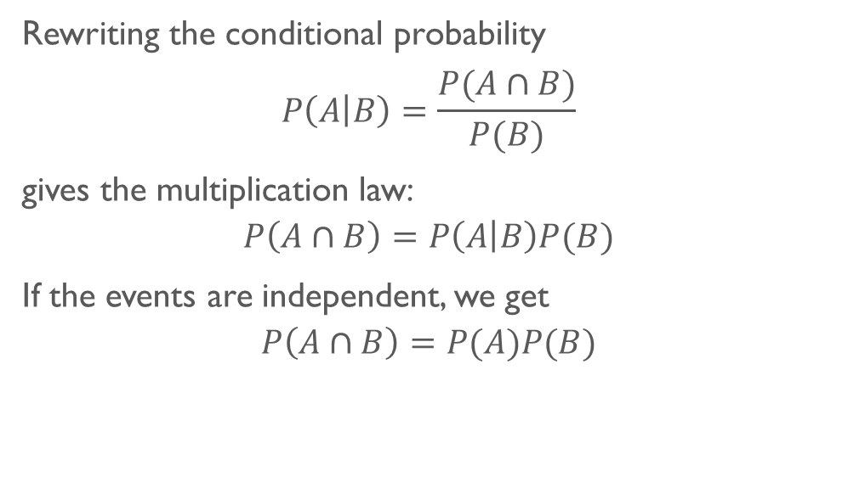
Multiplication law
Rewriting the conditional probability
$$P\left(A | B\right)=\frac{P(A∩B)}{P(B)}$$
gives the multiplication law:
$$P\left(A∩B\right)=P\left(A | B\right)P(B)$$
If the events are independent, we get
$$P\left(A∩B\right)=P(A)P(B)$$

Slide 42
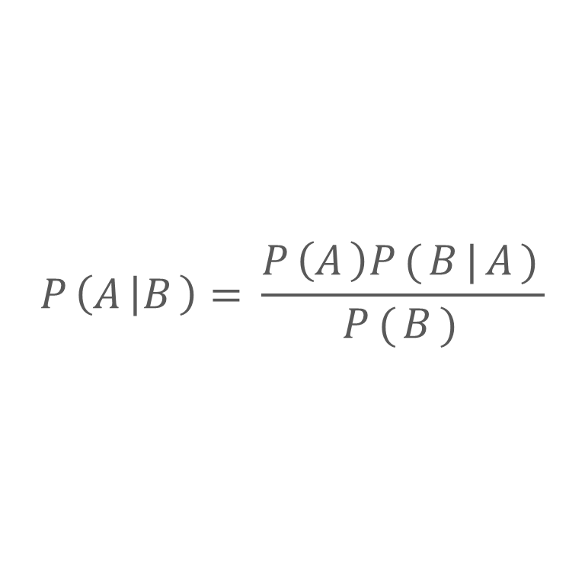
Bayes theorem
$$P\left(A | B\right)=\frac{P\left(A\right)P(B|A)}{P(B)}$$

Slide 43
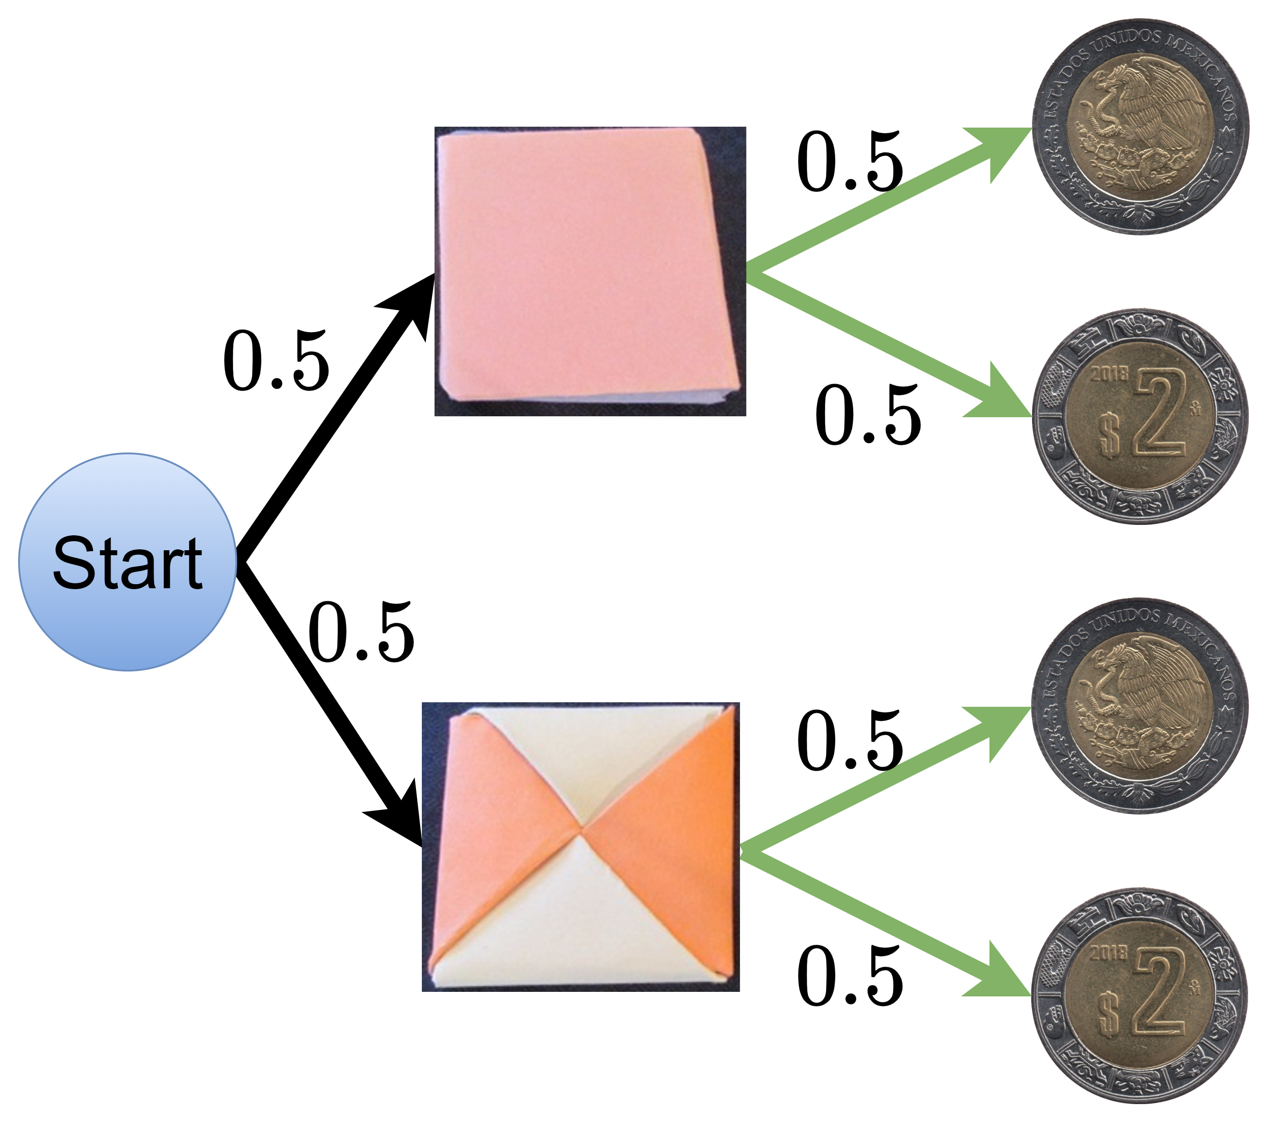
Example
Calculate probability of falling heads in the game where first we flip a Ddakji and then we toss a coin. Assume that the coin and the Ddakji are fair.

Slide 44
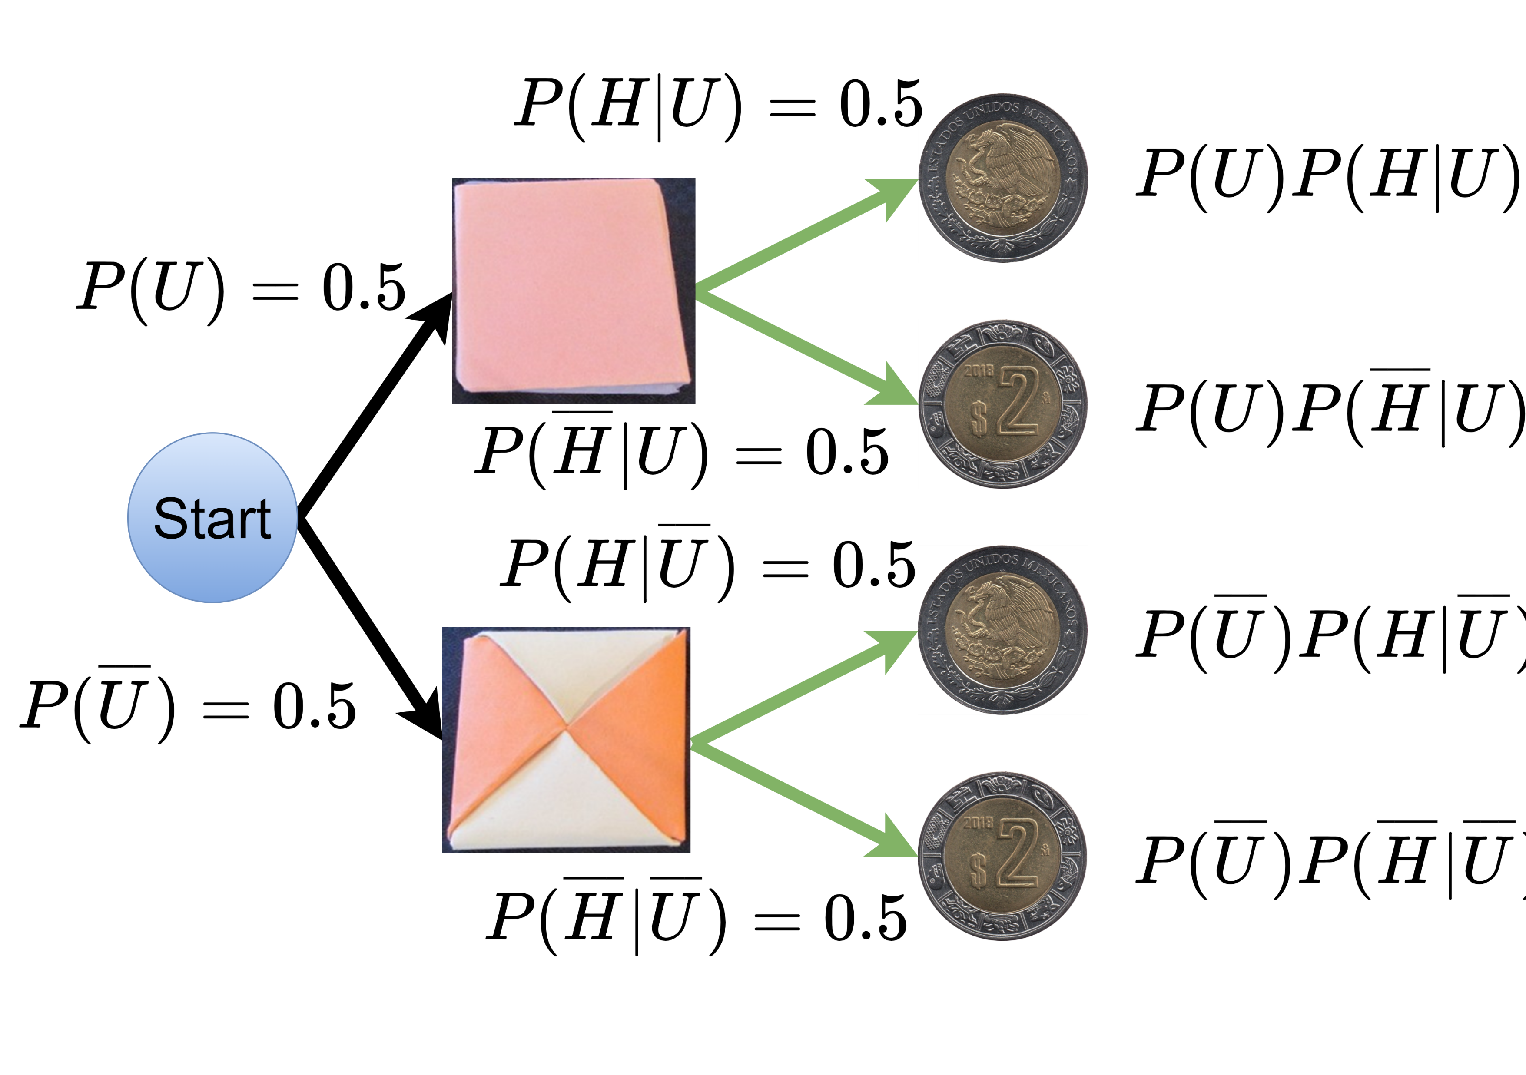
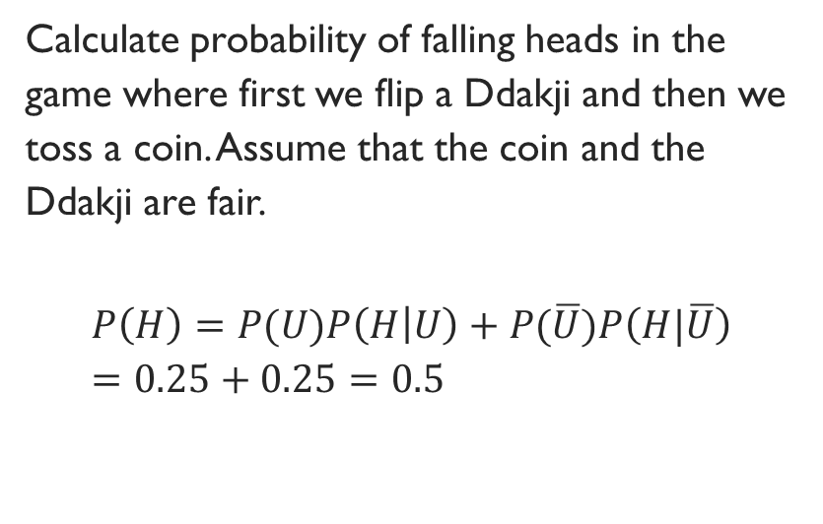
Solution
Calculate probability of falling heads in the game where first we flip a Ddakji and then we toss a coin. Assume that the coin and the Ddakji are fair.
$$P\left(H\right)=P(U)P\left(H | U\right)+P(\overline{U})P\left(H|\overline{U}\right)=0.25+0.25=0.5$$

Slide 45
Example
John visited New York city (of population is 8.5 million) to celebrate new year in the year 2020. Unfortunately, corona virus broke-out in the city and infected 85 people. Worried John, had himself tested with Polymerase chain reaction (PCR) and received a positive test result. What is the probability that John is infected with Corona virus if we assume
PCR has gives correct positive 98% and
PCR gives false positive 1%.
John is not convinced with the test and took test from another diagnostic center and found positive again. What is the probability now with the latest information?
He repeated the test again and found positive yet again, what is the probability now?

Slide 46
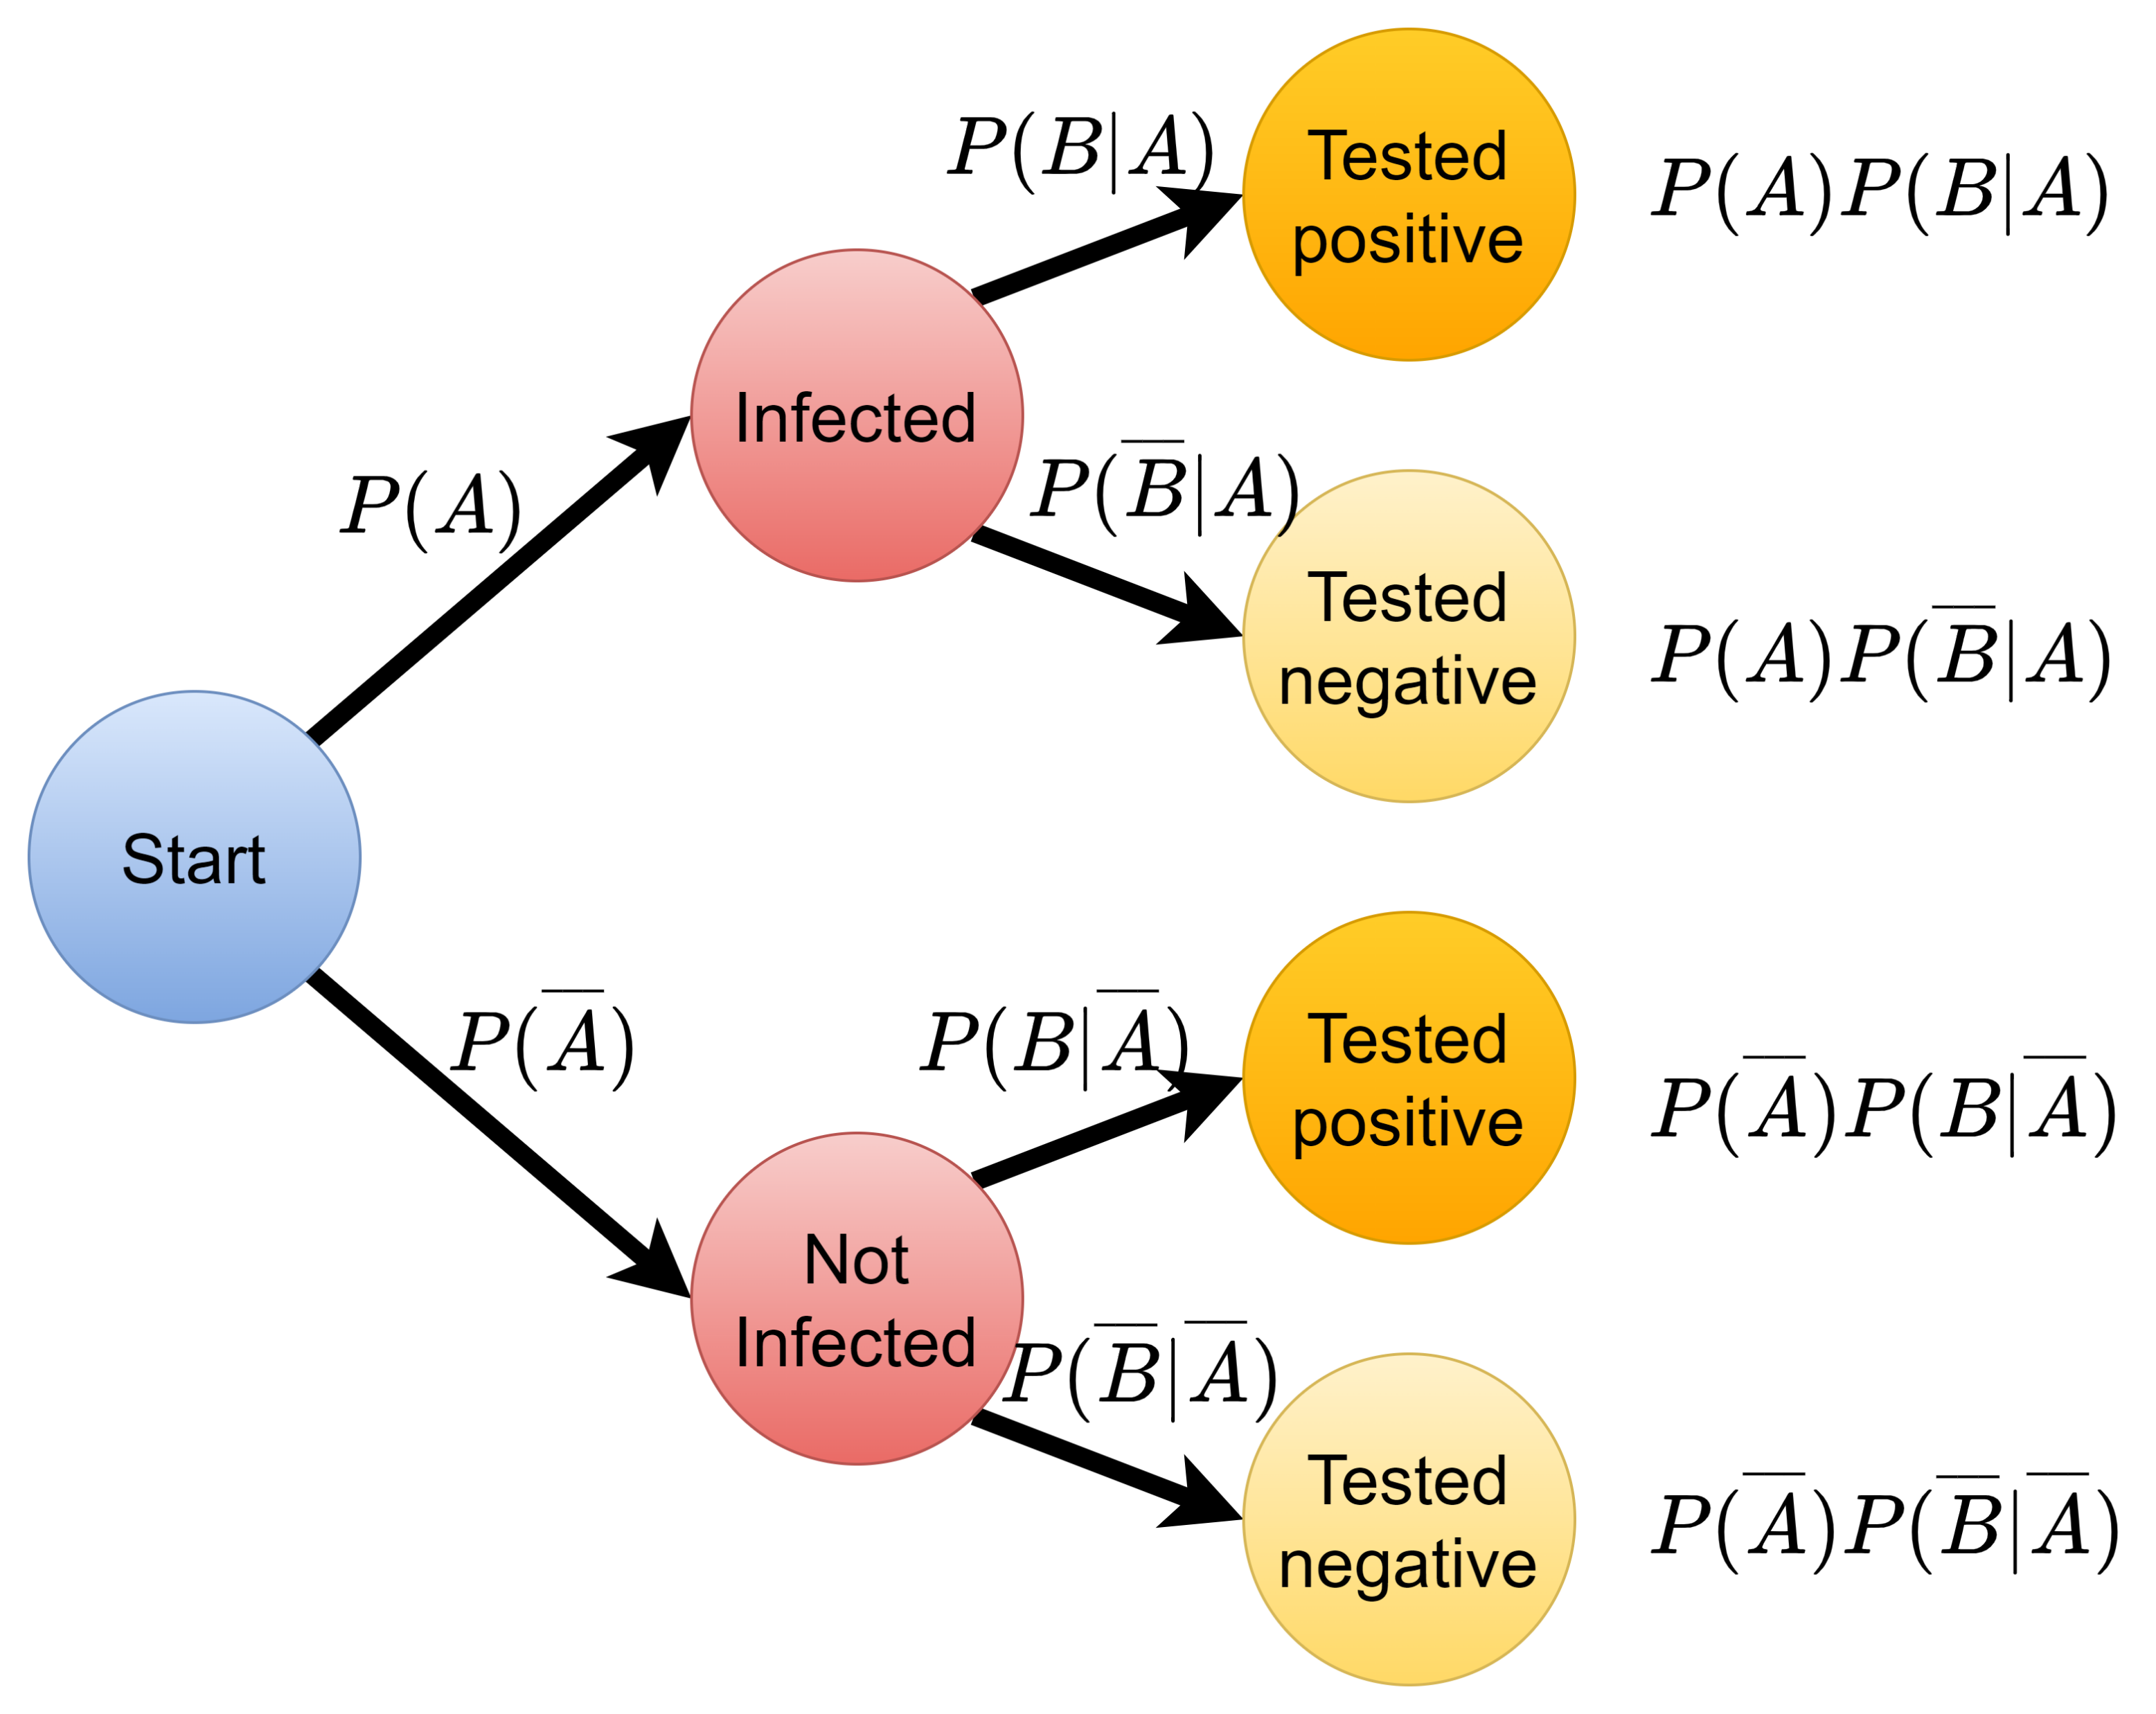

Tree diagram
$A$: John is infected with Corona virus
$B$: John is tested positive in a test

Slide 47
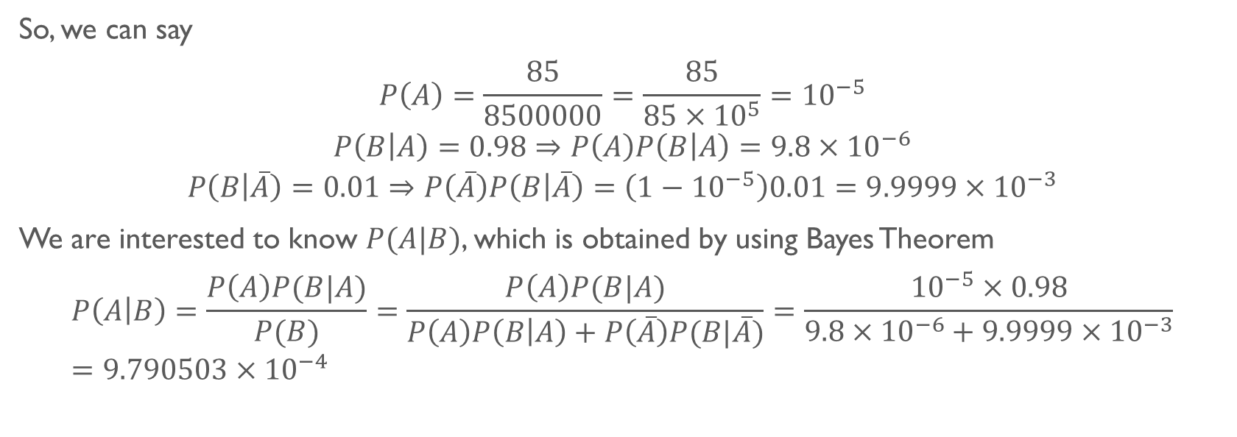
Solution
So, we can say
$$P\left(A\right)=\frac{85}{8500000}=\frac{85}{85×{10}^{5}}={10}^{−5}$$
$$P\left(B | A\right)=0.98⇒P\left(A\right)P\left(B | A\right)=9.8×{10}^{−6}$$
$$P\left(B | \overline{A}\right)=0.01⇒P\left(\overline{A}\right)P\left(B | \overline{A}\right)=\left(1−{10}^{−5}\right)0.01=9.9999×{10}^{−3}$$
We are interested to know $P(A|B)$, which is obtained by using Bayes Theorem
$$P\left(A | B\right)=\frac{P\left(A\right)P(B|A)}{P(B)}=\frac{P\left(A\right)P(B|A)}{P\left(A\right)P\left(B | A\right)+P\left(\overline{A}\right)P(B|\overline{A})}=\frac{{10}^{−5}×0.98}{9.8×{10}^{−6}+9.9999×{10}^{−3}}=9.790503×{10}^{−4}$$

Slide 48
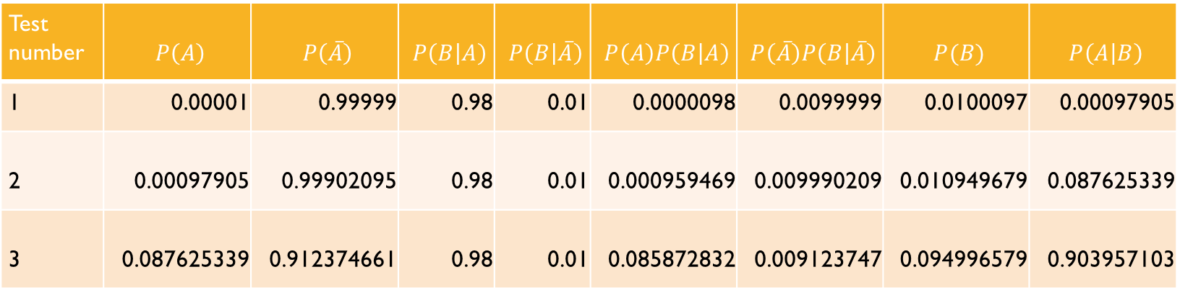
Solution
Test number | $$P\left(A\right)$$ | $$P\left(\overline{A}\right)$$ | $$P\left(B | A\right)$$ | $$P\left(B | \overline{A}\right)$$ | $$P\left(A\right)P\left(B | A\right)$$ | $$P\left(\overline{A}\right)P\left(B | \overline{A}\right)$$ | $$P(B)$$ | $$P\left(A | B\right)$$
1 | 0.00001 | 0.99999 | 0.98 | 0.01 | 0.0000098 | 0.0099999 | 0.0100097 | 0.00097905
2 | 0.00097905 | 0.99902095 | 0.98 | 0.01 | 0.000959469 | 0.009990209 | 0.010949679 | 0.087625339
3 | 0.087625339 | 0.912374661 | 0.98 | 0.01 | 0.085872832 | 0.009123747 | 0.094996579 | 0.903957103

Slide 49

Tank you
For your attention

